Slide 1
Intermediate Git

Slide 2
Goals
Get Comfortable with Git features
Introduction to GitFlow

Slide 3
Agenda
Quick Demo
Why You Should Give A Rat’s A$$
Definitions
Workflow

Slide 4
Quick Demo

Slide 5

So What

Slide 6

Forking

Slide 7
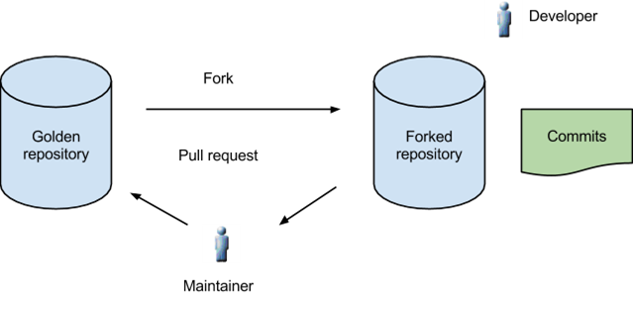
Git Fork

Slide 8
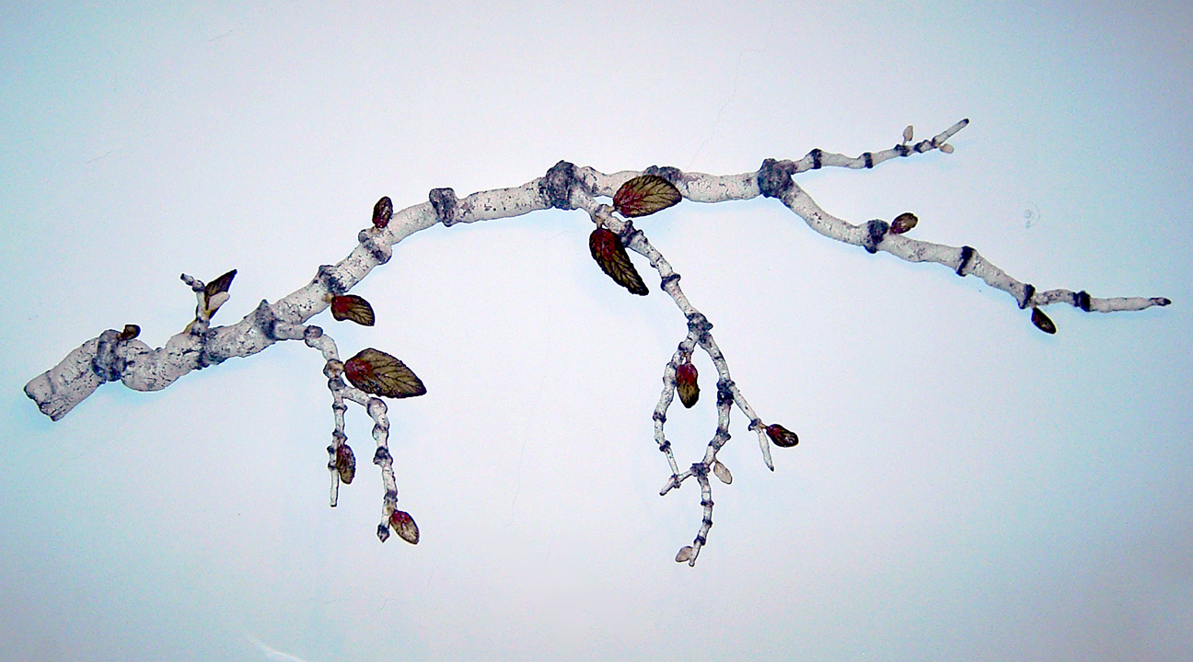
Branch

Slide 9
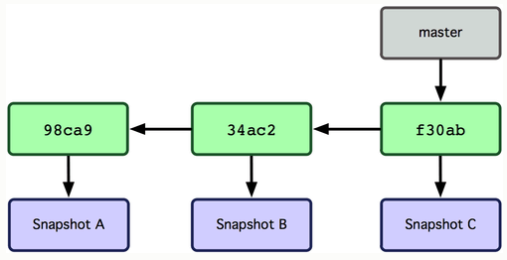
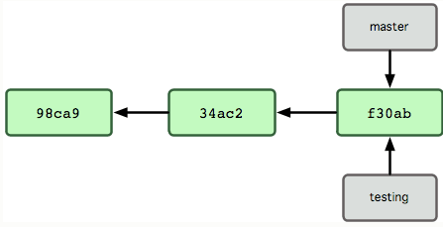
Git Branching

Slide 10
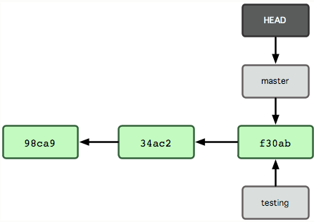
Git Branching

Slide 11
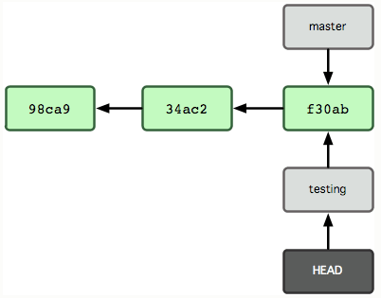
Git Branching

Slide 12
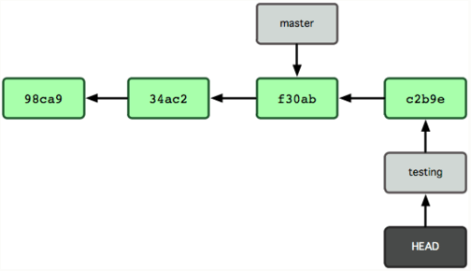
Git Branching

Slide 13

Merge

Slide 14
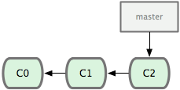
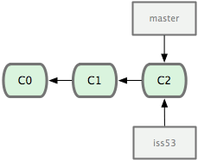
Git Merge

Slide 15
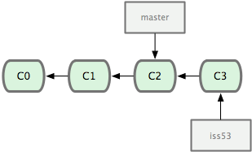
Git Merge

Slide 16
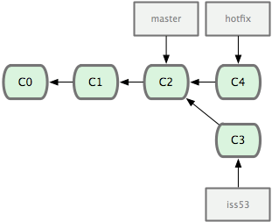
Git Merge

Slide 17
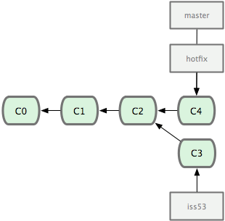
Git Merge

Slide 18
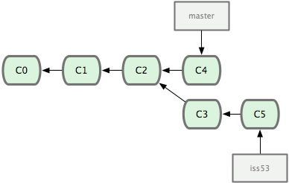
Git Merge

Slide 19
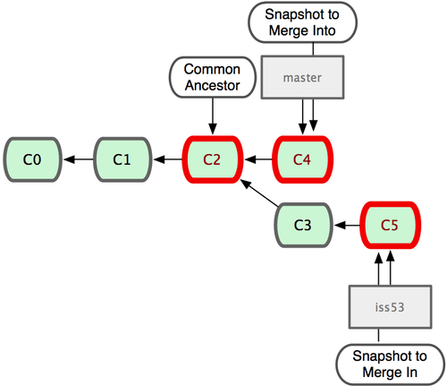
Git Merge

Slide 20
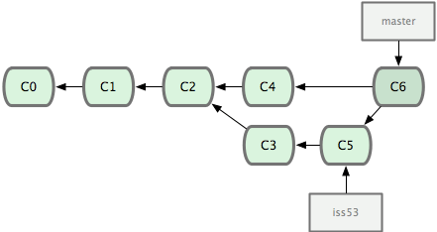
Git Merge

Slide 21
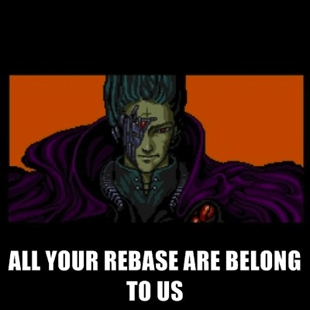
Rebase

Slide 22
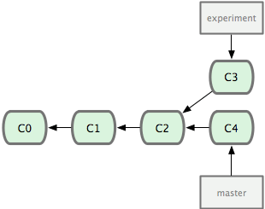
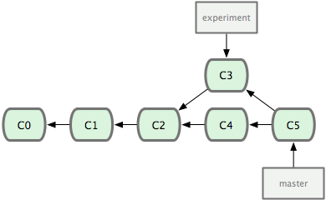
Git Rebase

Slide 23
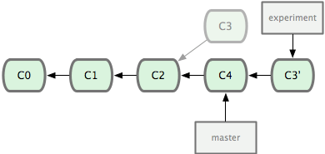
Git Rebase

Slide 24
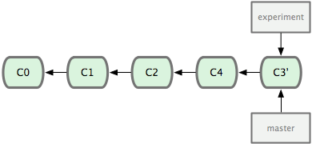
Git Rebase

Slide 25

Stash

Slide 26

GitFlow

Slide 27
GitFlow Goals
Stable Releases
Stable Test Environment
Easy to fix bugs in production
Easy to create new features

Slide 28
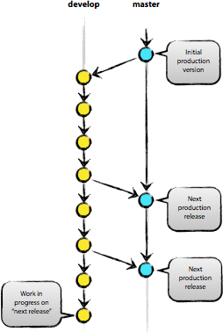
GitFlow – Development

Slide 29
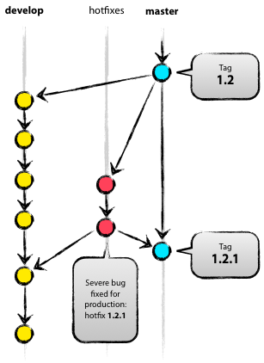
GitFlow – Fixing Bugs

Slide 30
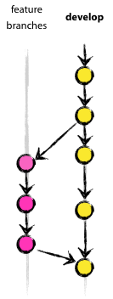
GitFlow – Feature Branches

Slide 31

Thank You

